Slide 1
Capturing the Baijiu(白酒) Industry Landscape:
A Textual Analysis Snapshot
and Predictive Modeling of Stock
Project of Group 3
Jialu Gao, Yunru Si, Zhuochu Li, Nuo Chen
20241025 DEDA Digital Economy Data Analytics, Group Work

Slide 2
Project Outlines
1. Motivations
2. Word Clouds
2.1 Word Cloud from Tang Poetry
2.2 Word Cloud from Baijiu Industry Reports
3. Topic Modeling with LDA
4. Interactive Graphs of Stock Prices
5. UMAP Analysis of Indices
6. Minimum Spanning Trees (MST)
6.1 Example 1: Time Series Segmentation
6.2 Example 2: Distance Between Stocks
7. Predictive Modeling
8. Conclusion

Slide 3
Motivations
What: Analytical Methods in the Digital Economy
The use of statistical techniques, machine learning algorithms, and quantitative tools to analyze historical data, identify patterns, and make financial forecasts, with a particular focus on stock prediction.
How: Project Implementation Approach
The project selects the Baijiu industry to depict its landscape through textual analysis and to dissect stock prices within the sector using a suite of analytical techniques.
To develop a predictive model that will serve as a cornerstone for understanding and anticipating stock market movements within the Baijiu industry.
Why Choose the Baijiu Industry
Cultural importance
Significance of the Baijiu Industry in the Stock Market

Slide 4

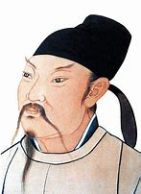

Poems of Baijiu
Part 1: Word Clouds
We created a word cloud of Tang poems about Baijiu!
(More interestingly, it was interestingly shaped like the figure of Li Bai!)

Slide 5
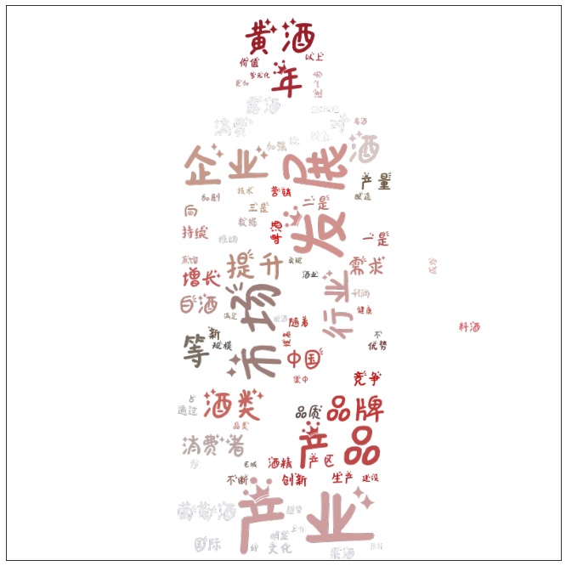
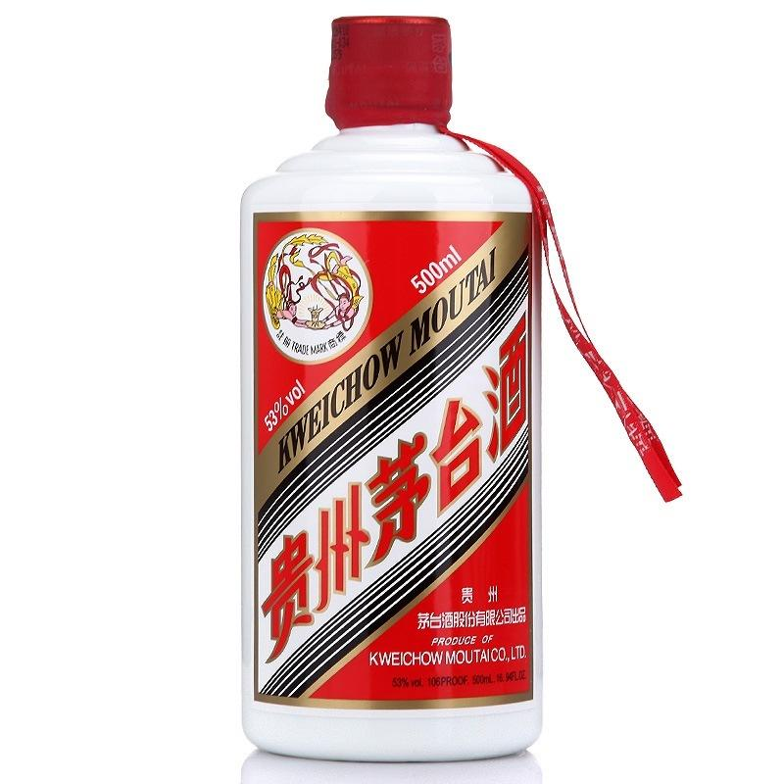
Reports of Baijiu
Part 1: Word Clouds
Then… We created a word cloud of Reports about Baijiu!
(Now it was interestingly shaped like the figure of Moutai.)

Slide 6
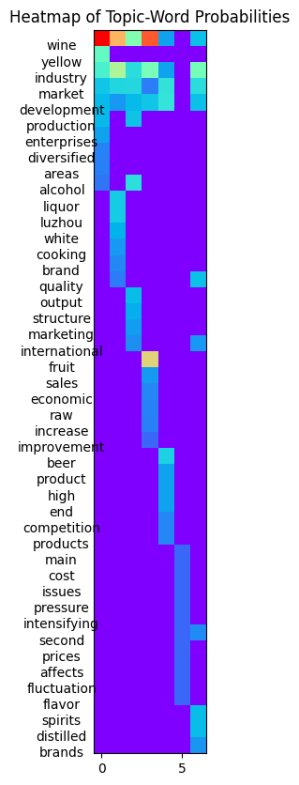
Heatmap of Topic-word Probabilities
Part 2: Topic Modeling with LDA
2023 Alcohol Industry Economic Operation Report
7 topics
Train LDA model using gensim
The heatmap with keywords and topics.

Slide 7
3.1 Data
Part 3: Data and Descriptive Statistics
Get stock data of Baijiu industry from 2014-09-20 to 2024-09-20
ts_code | trade_date | open | high | low | close | vol | amount
600696.SH | 2024/9/20 | 5.9 | 6.42 | 5.9 | 6.42 | 214449.69 | 135185.996
600696.SH | 2024/9/19 | 4.78 | 5.84 | 4.78 | 5.84 | 246984.96 | 132328.033
600696.SH | 2024/9/18 | 5.31 | 5.31 | 5.31 | 5.31 | 13745 | 7298.595
600696.SH | 2024/9/13 | 5.9 | 5.9 | 5.9 | 5.9 | 21119 | 12460.21
600696.SH | 2024/9/12 | 6.55 | 6.55 | 6.55 | 6.55 | 27509 | 18018.395
600696.SH | 2024/9/11 | 7.48 | 7.73 | 7.21 | 7.28 | 168767.31 | 124978.13
600696.SH | 2024/9/10 | 7.61 | 8.1 | 7.53 | 7.82 | 180991.88 | 141842.646
600696.SH | 2024/9/9 | 7.48 | 7.65 | 7.38 | 7.54 | 59482.97 | 44719.115
600696.SH | 2024/9/6 | 7.78 | 7.81 | 7.57 | 7.61 | 79839 | 61215.135

Slide 8
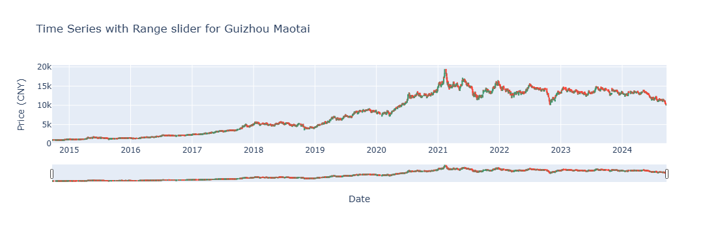
3.2 Interactive Visualisations
Part 3: Data and Descriptive Statistics
Interactive Visualisations of the stock Guizhou Maotai (贵州茅台)
Choose 贵州茅台 600519.SZ from all stocks
Sort the data by date
Plot graph

Slide 9
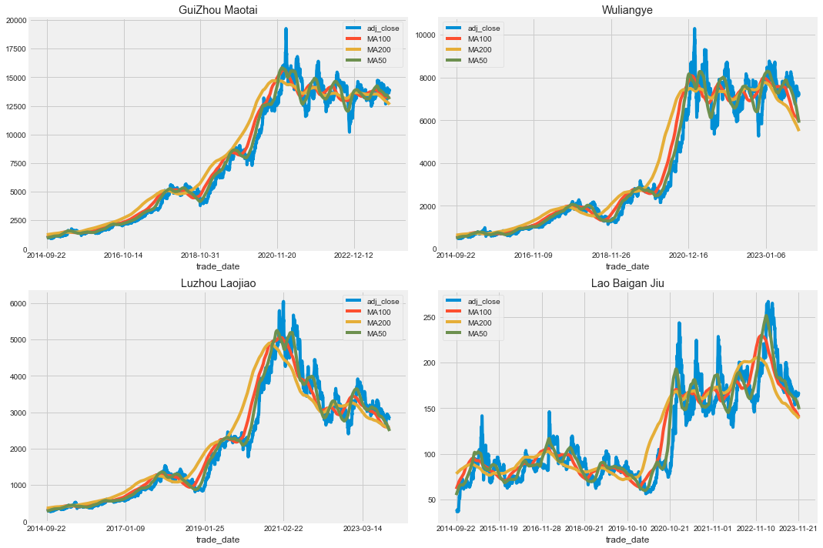
3.3 Moving Average of the various stocks
Part 3: Data and Descriptive Statistics

Slide 10
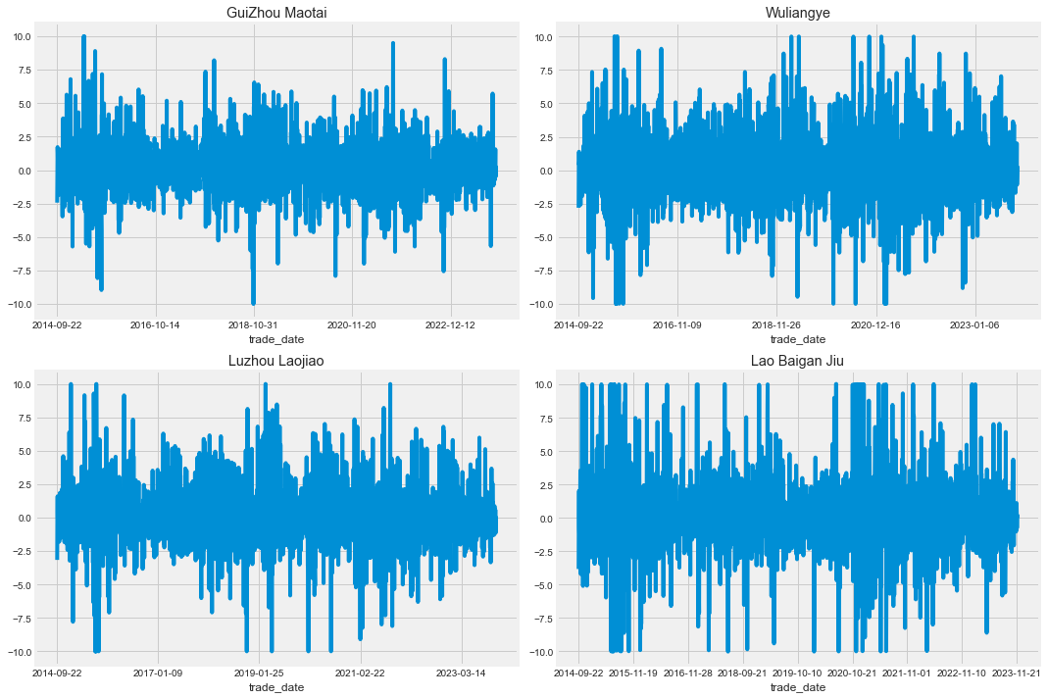
3.4 Daily Return
Part 3: Data and Descriptive Statistics

Slide 11
4. UMAP
Part 4: UMAP
The stock data creates a high dimensional feature space
open, high, low, close, volume, etc.
UMAP for dimensionality reduction
Preserving Global Structure
Improved Interpretation
To uncover hidden patterns and relationships between stocks that might be obscured in the original high-dimensional space.

Slide 12
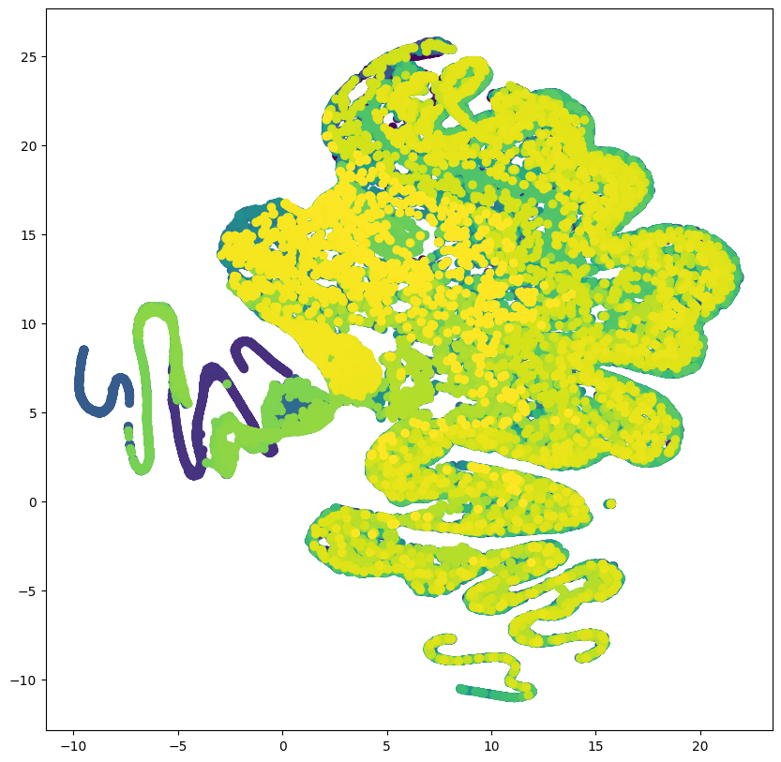
4.1 UMAP Dimensionality Reduction
Part 4: UMAP
Using UMAP before clustering will likely lead to more interpretable results than applying a clustering algorithm directly to the raw, high-dimensional data.

Slide 13
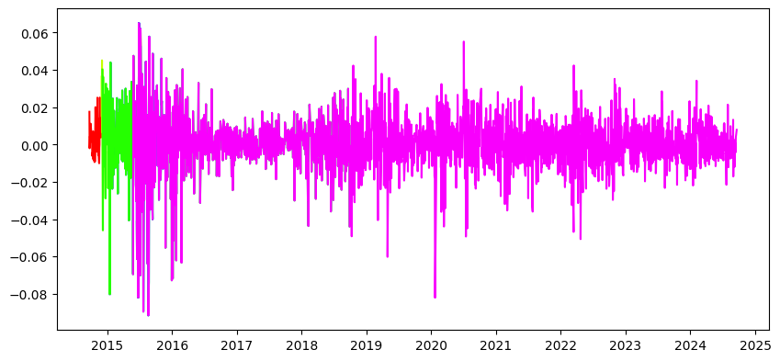
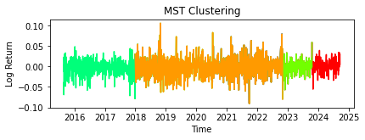
Minimum Spanning Trees with Time Series
Part 5: Minimum Spanning Trees with Time Series
“Time Series clustering”
Index:
Stock: e.g., MOUTAI(贵州茅台)

Slide 14
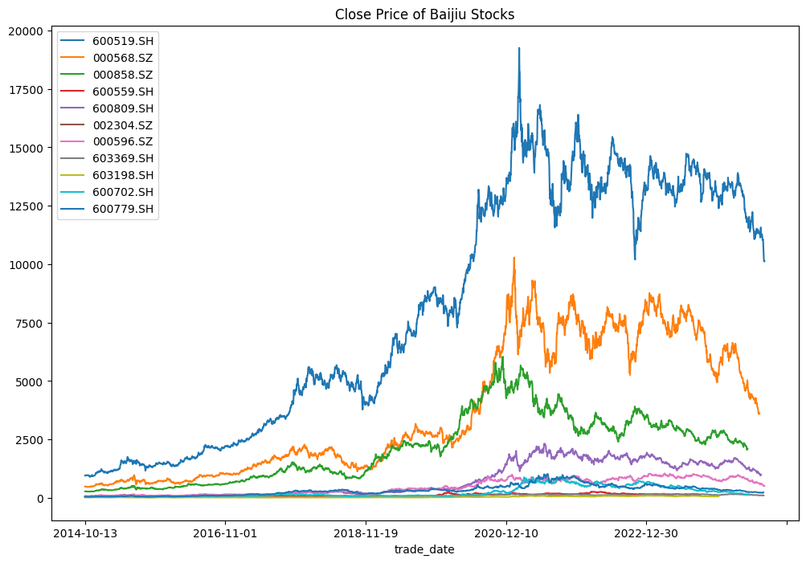
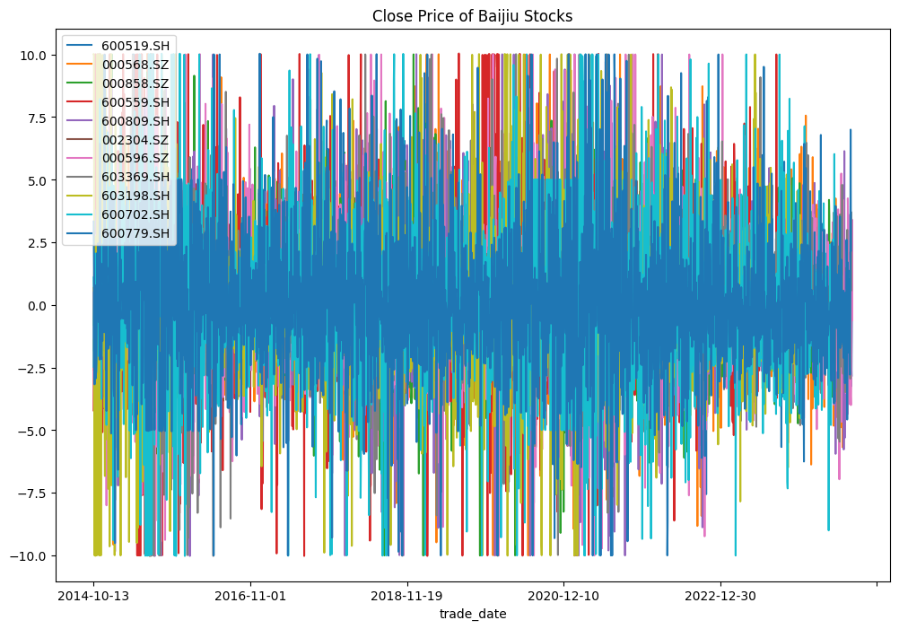
Minimum Spanning Trees within Stocks
Part 6: Minimum Spanning Trees within Stocks
10 Baijiu Stocks
From 2014 to 2024
Close prices and Percent Changes of Baijiu stocks
Close Price of Baijiu Stocks Gain/loss percentage of Baijiu Stocks
Close price of Baijiu Stocks
Percent Changes of Baijiu Stocks

Slide 15
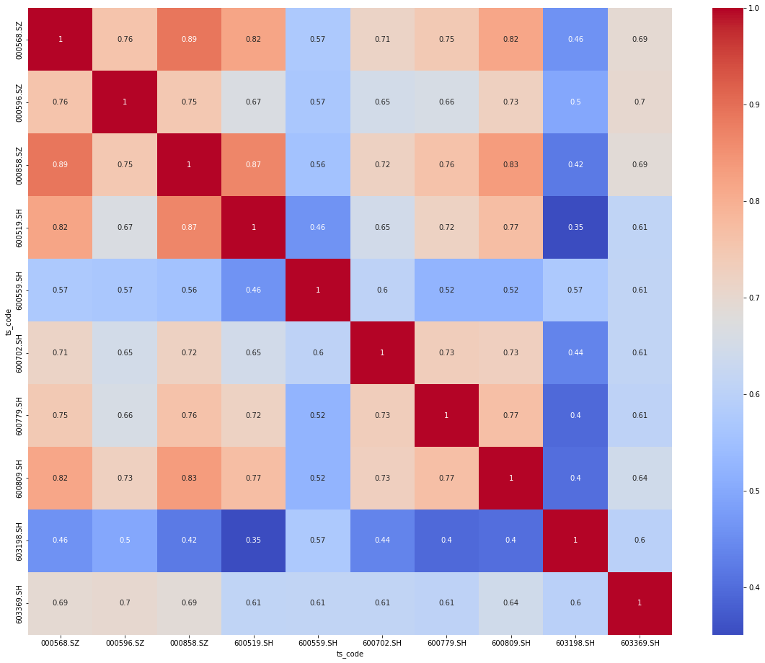
Heatmap of correlation matrix
Part 6: Minimum Spanning Trees within Stocks

Slide 16
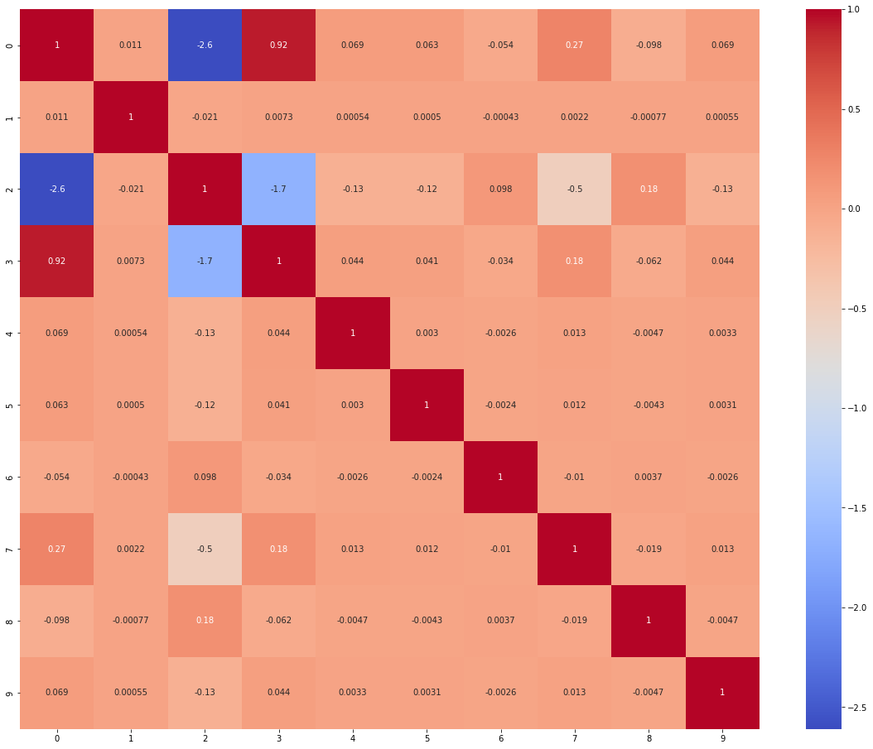
Heatmap of filtered correlation matrix
Part 6: Minimum Spanning Trees within Stocks

Slide 17
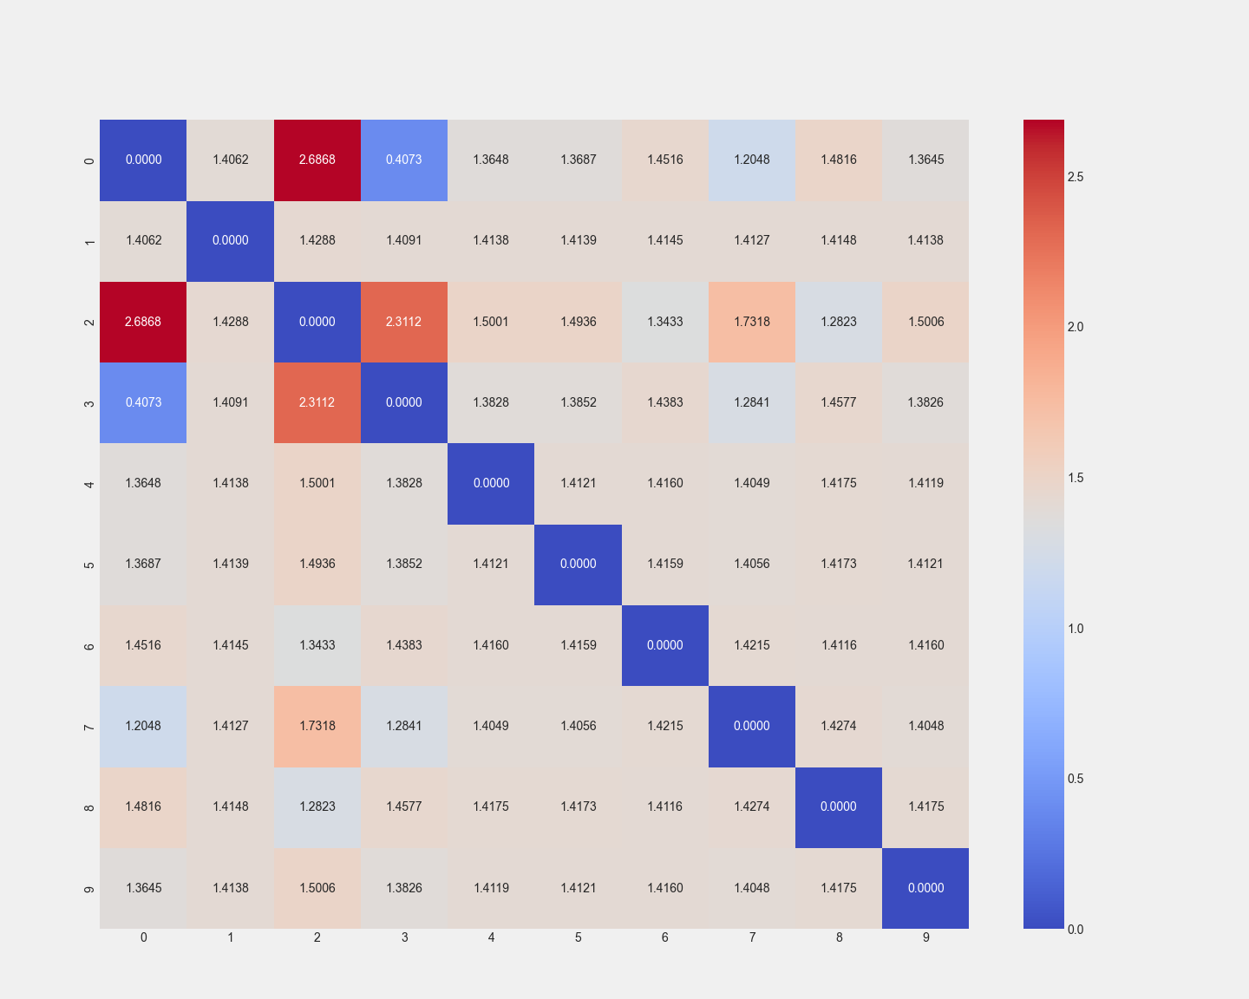
Distance Matrix
Part 6: Minimum Spanning Trees within Stocks

Slide 18
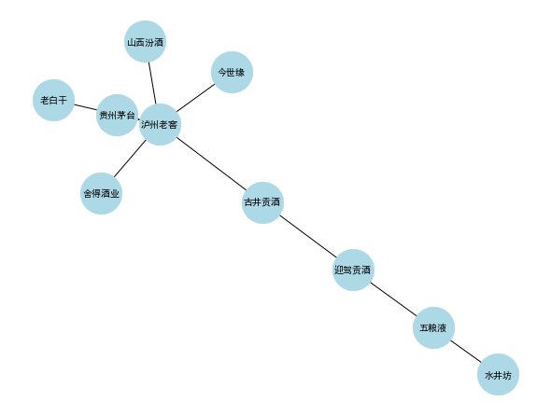
MST of 10 Baijiu Stocks
Part 6: Minimum Spanning Trees within Stocks
MST of 10 Baijiu Stocks
The length of the line segment represents the magnitude of the correlation.

Slide 19
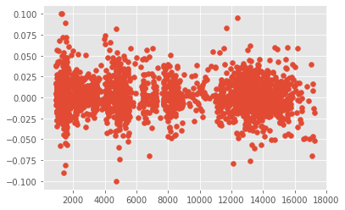
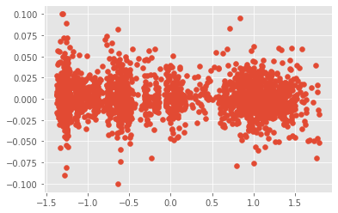
7.1 Volume Weighted Average Price
Part 7: Predictive Modeling
Volume Weighted Average Price
Standardize each column except the 'label' column in the DataFrame

Slide 20
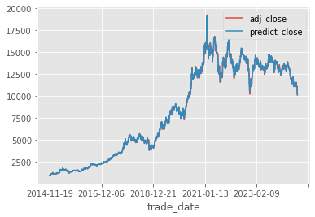
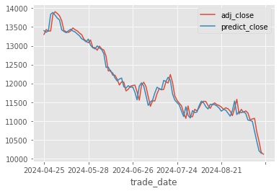
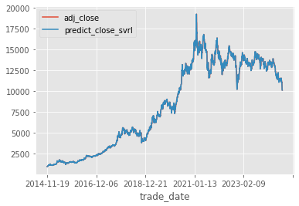
7.2 Predictions
Part 7: Predictive Modeling
Setting
Apply 70 factors
Train and test data set
Method 1: Linear Regression
Though the prediction results are not that good, we can still learn valuable insights from the analysis.
Method 2: Support Vector Machine

Slide 21
Conclusions
8. Conclusions

